Slide 1
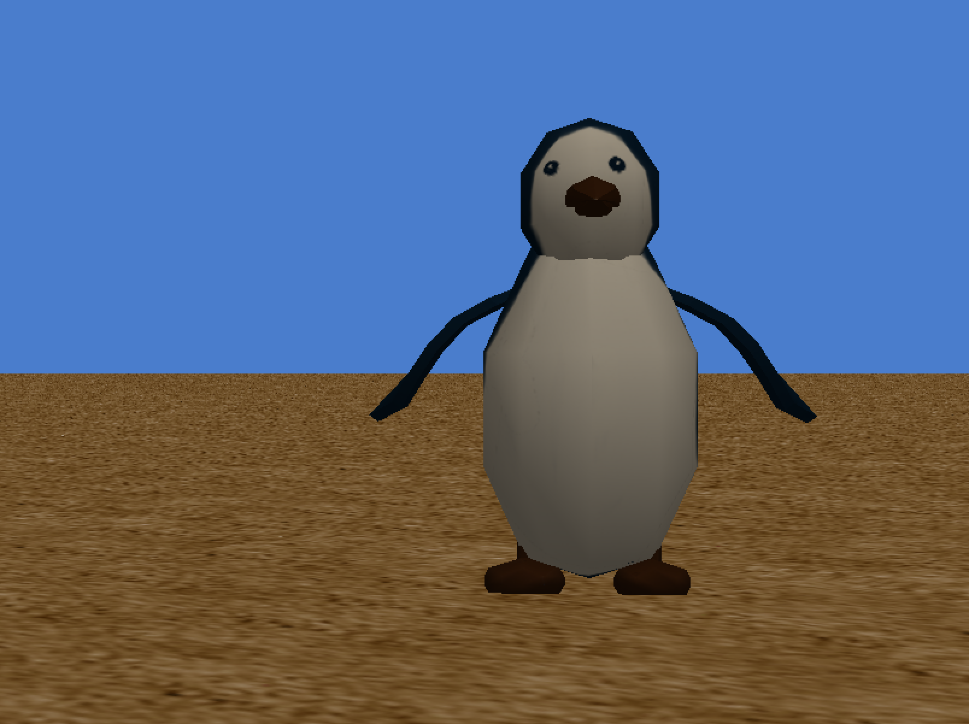
Playing Music in Alice
By David Yan
Under the direction of Professor Susan Rodger
July 2015

Slide 2
Getting Music
There are many options to get music off the internet
If you have your own music then you can just import those directly into Alice
This tutorial will show how to get music snippets by first downloading them off the internet then trimming them to segments that are shorter than 30 seconds

Slide 3
WARNING: USE SHORT CLIPS
When you are considering using music for use in Alice, please try to limit your music clips to be 30 seconds or less.
If you do this then less memory will be used to store your Alice World and you will still be within legal boundaries when it comes copyright issues.
Sound files can take up a lot of memory in your Alice world so try to keep sound clips as small as possible. Uploading entire songs is not recommended.

Slide 4
Getting Music From Youtube
Once you get to Youtube and locate the song whose audio you want to save, grab the url of the video.
To do this, right click on the video and select “get video url.” Once the url is selected, copy it so that you can paste that url later.

Slide 5
Saving the Video as a MP3 File
There are many services on the internet that will allow you to save Youtube videos as MP3 sound files.
For this tutorial we will only show you one of these services.
One of the most popular can be found at this link: http://www.youtube-mp3.org/
Once you are on this site, just simply paste the url of the Youtube video and select “Convert Video.”
The video should now be downloaded as a .mp3 file in your downloads folder.

Slide 6
Other Considerations
This tutorial will cover how to trim music files for both Mac and PC as well as how to import them into Alice.
For this tutorial, we will demonstrate QuickTime for Mac users (beginning on slide 7) and Audacity for PC users (beginning on slide 14).
Note that there are many other services you can use but for now we will just use QuickTime and Audacity

Slide 7
Trimming the Music File For Mac Users
If you want only a snippet of the music file that you have downloaded, then you will have to trim the music file. For mac users, this can be done very simply through the QuickTime player that is already installed on your mac.
Open the QuickTime Player (notice that no windows or anything pop up)
However, you can see the QuickTime icon show up in your dock.
Select the QuickTime icon and notice that your taskbar at the top of the screen changes to this:

Slide 8
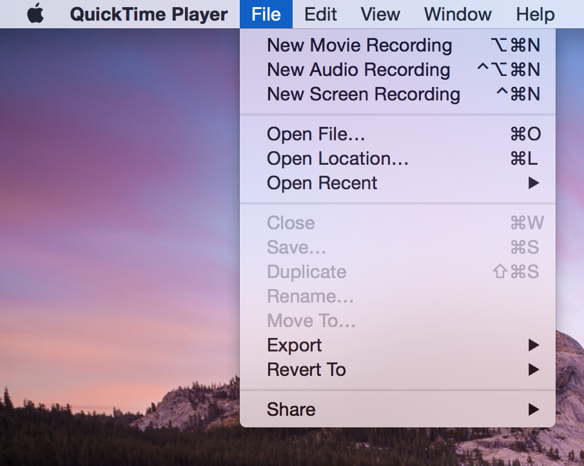
Opening the Music File in QuickTime (Mac)
Now that you have QuickTime opened, open the sound file that you would like to trim

Slide 9
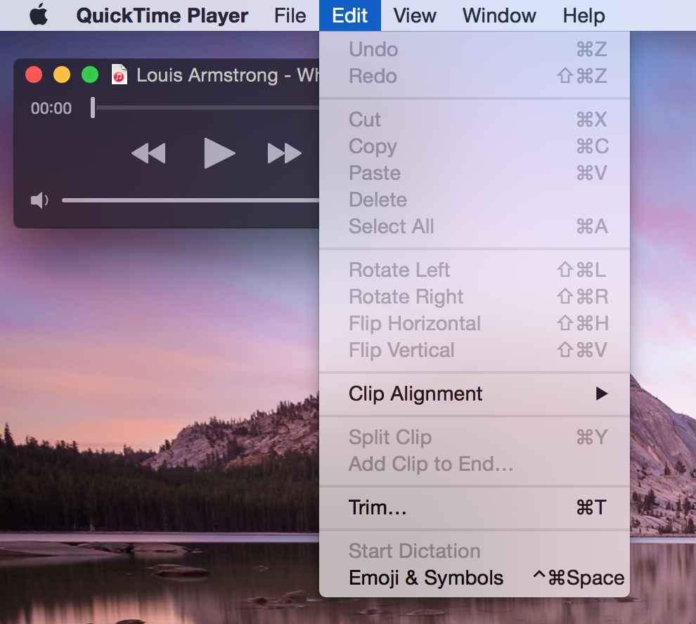
Trimming the Music File (Mac)
Now that your sound file is opened in QuickTime, we can use the QuickTime trim property.
To access this, just go to QuickTime>Edit>Trim.

Slide 10
Trimming the Music File (Mac)
Once you have trim selected, just select the range of the sound by moving the yellow trim box around the range of music that you want to keep and then hit “trim” when you are done. This may take a couple tries as you really figure out a precise range of sound that you would like to keep.

Slide 11
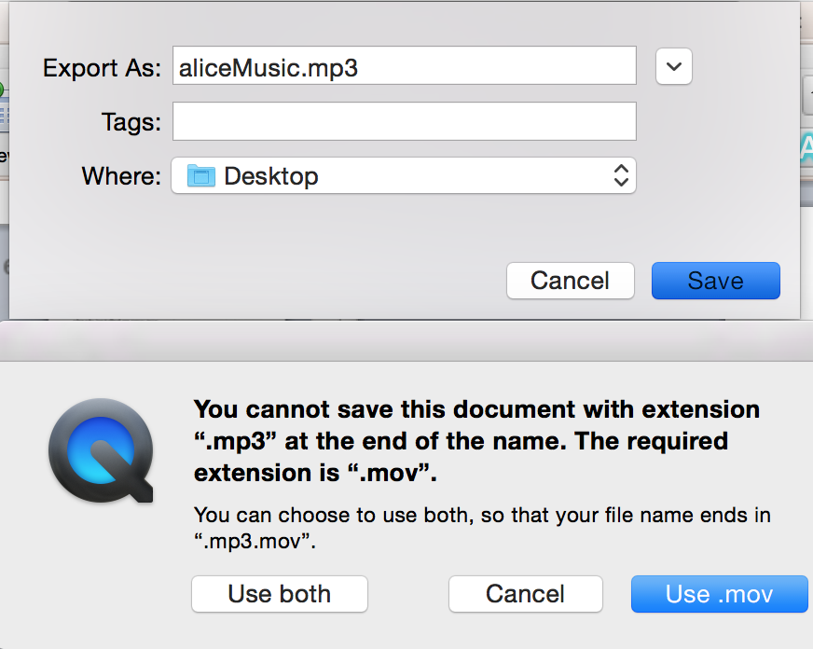
Trimming the Music File (Mac)
Once you have trimmed your new music file, we now have to save the video as a .mp3 file since QuickTime defaults to a .mov file. I will save my file with filename “aliceMusic.mp3”
QuickTime will give you an error if you try to save it as an .mp3 file so when this error message pops up, be sure to select “use both.”

Slide 12
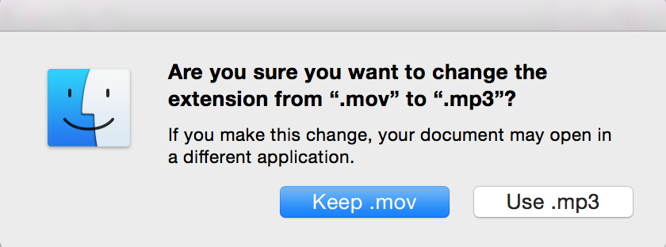
Trimming the Music File (Mac)
Now locate the folder where you saved your music file.
It should look like this so far in your folder:
Double click this file to rename it and just rename it to “aliceMusic.mp3” This message will pop up and just select “Use .mp3”:

Slide 13
Final Step for Mac
Now that you have saved your new trimmed file as a .mp3 file, you are ready to import it into Alice!
Your file should now look like this in its folder:

Slide 14
Trimming the Music File For PC Users
One very simple free program for PC users to use for this purpose is Audacity. The download for Audacity can be found here: http://sourceforge.net/projects/audacity/
Once you have Audacity opened, go to File>Open then select the audio file you want to edit.

Slide 15
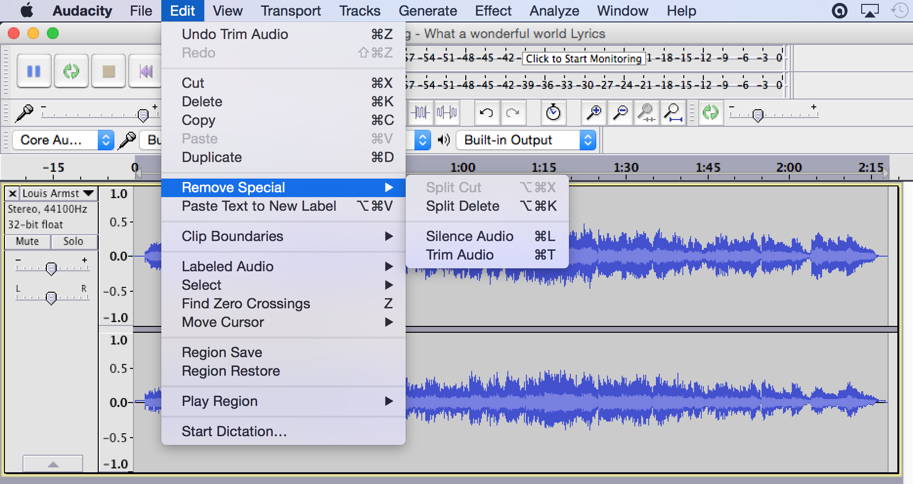
Trimming Music for PC
To trim music in Audacity, go to Edit>Remove Special>Trim Audio

Slide 16
Trimming Music for PC
Once you have selected the Trim Audio option, just drag your cursor over the area of sound that you would like to keep.
The selected area should be covered by a gray box like this:
Once you have selected the area, just go to Edit>Remove Special>Trim Audio again and your file will be trimmed

Slide 17
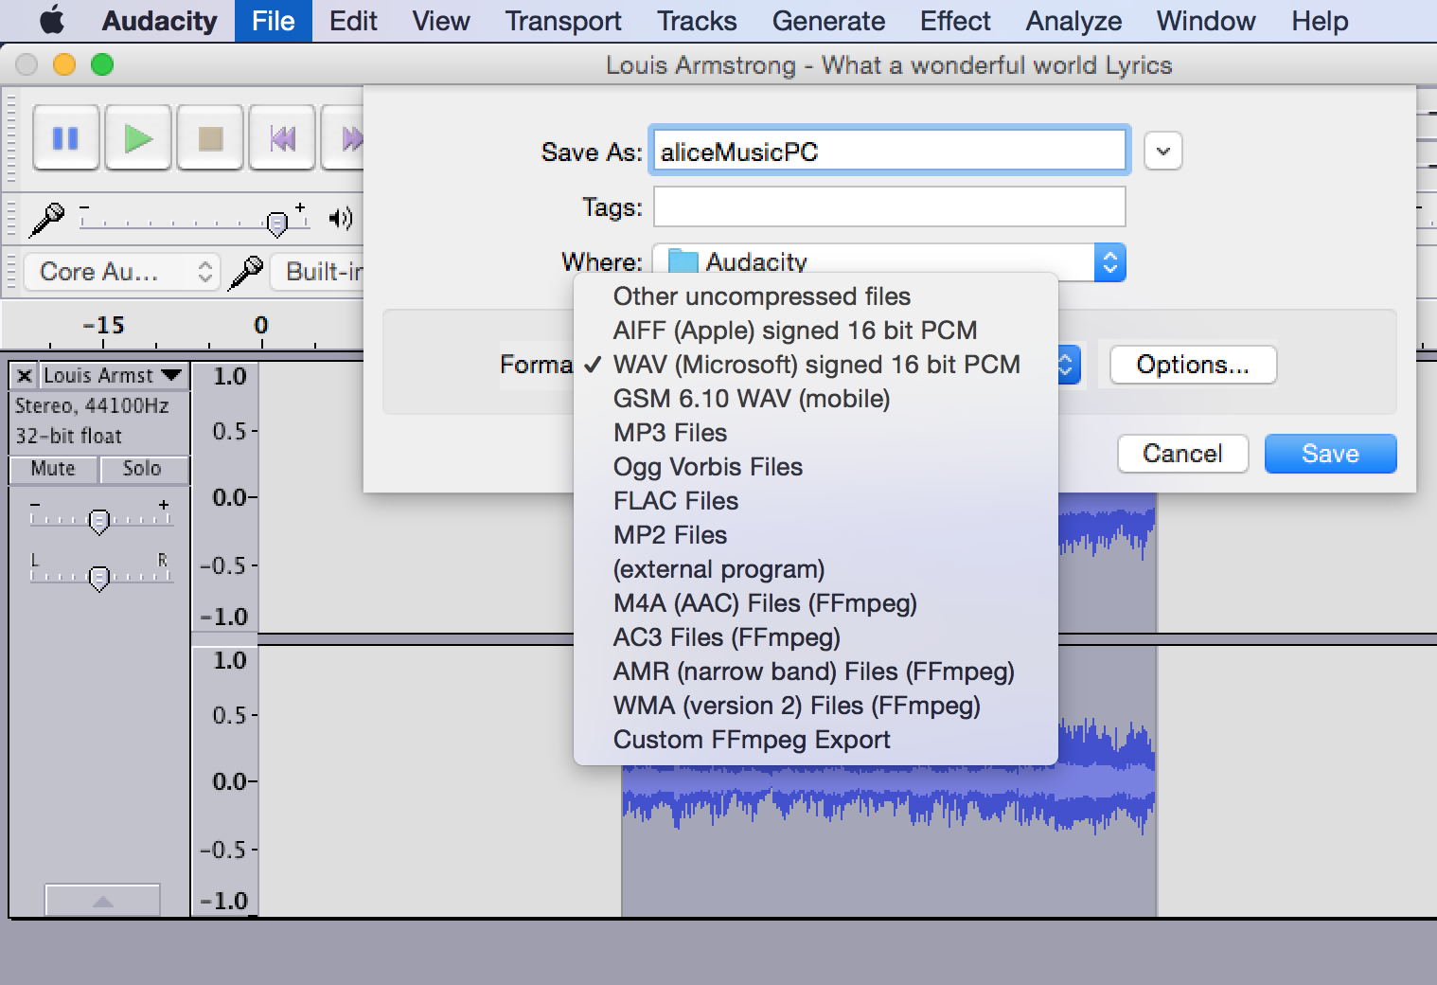
Exporting Your Trimmed Music File (PC)
Now we need to export your trimmed file as a MP3 file.
To do this in Audacity, go to File>Export Audio.
When this popup box appears, select MP3 Files as the file type.

Slide 18
Once you have your music files set up you can now import them into Alice!

Slide 19
Importing Sounds Into Alice
Now that your files are set up, we will now import these sound files into Alice
For this tutorial, I will import these sounds into the soundStarterWorld.a2w file that is attached to this tutorial.

Slide 20
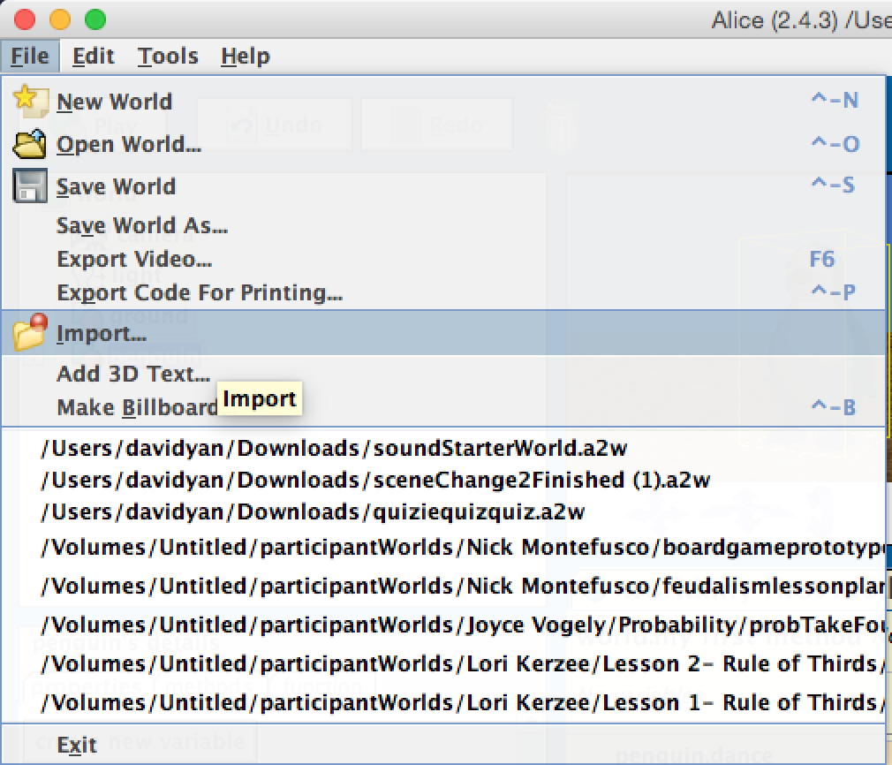
Importing Sounds into Alice
When you open and play soundStarterWorld, you will notice that a penguin dances … to no music.
Let’s fix this by importing the music files that we have made.
To import a sound into Alice, go to Alice>File>Import
Once you have the import window open, choose the sound file that you would like to play in Alice.

Slide 21
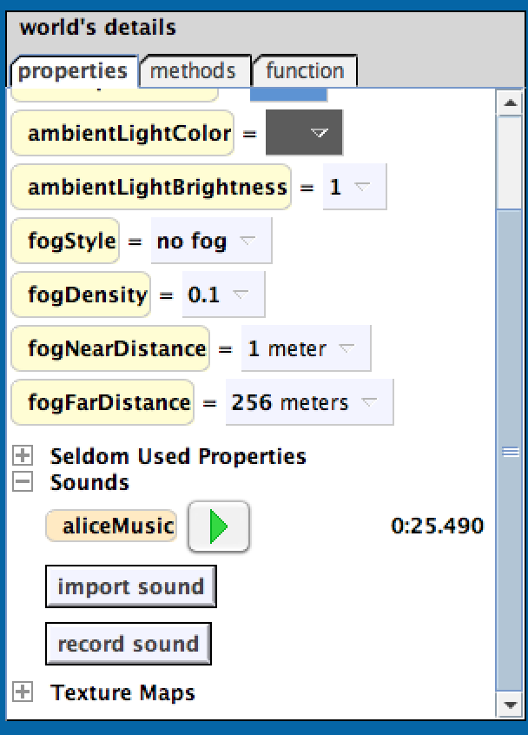
Importing Sounds into Alice
I have imported my “aliceMusic.mp3” file into the world.
Once you have selected the sound file you want to import from the import window earlier, we need to locate the sound file in your Alice world.
To find the sound file, select World in your object tree, then go to World>Properties Tab> then scroll down in your properties tab until you find “sounds.” Click the plus sign beside “sounds” and you will find the sound that you have imported there.

Slide 22
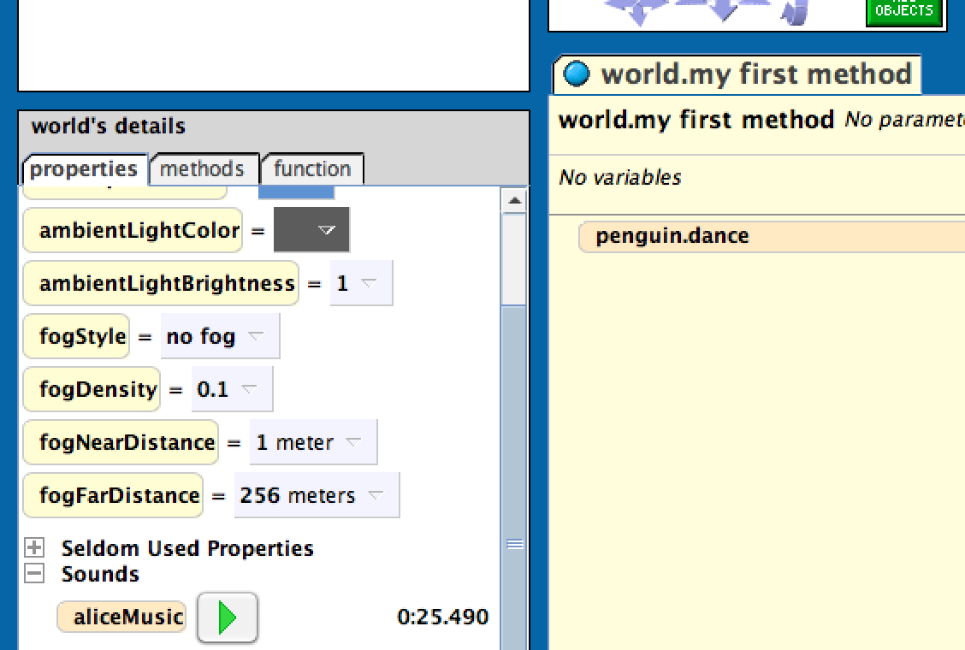
Playing Sounds in Alice
Now that we have found our sound file in Alice, we are going to want to play it.
This is very simple. Simply grab your sound in the World Properties>Sounds tab and drag it into your method space.

Slide 23
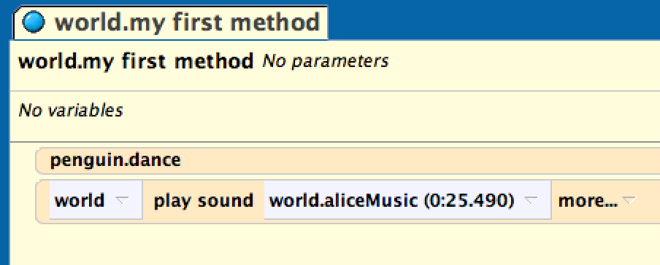
Playing Sounds in Alice
Your World.my first method should look like this now:

Slide 24
Final Step
We probably don’t want to have the penguin dance then have the sound play so let’s have the music playing while the penguin is dancing!
To do this, we will just place both in a do together block!
Just drop in a do-together block and put both lines of code into that block.

Slide 25
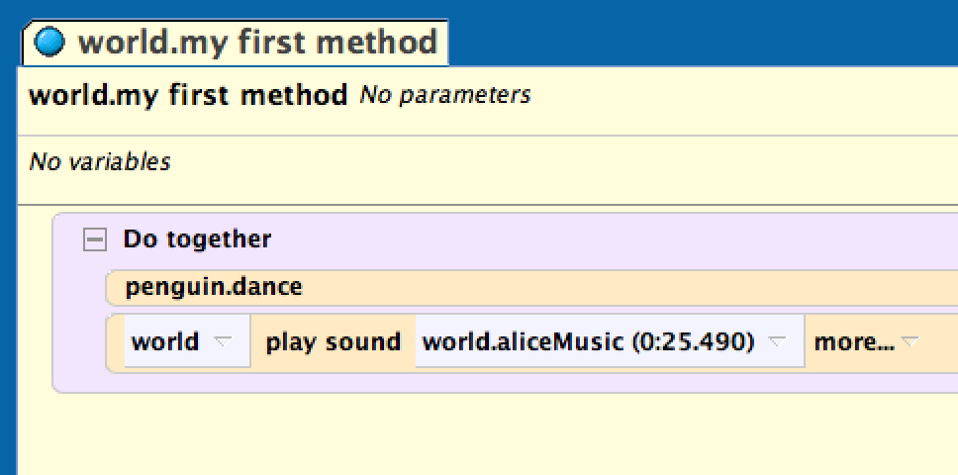
Final Code
Your final method should look like this:

Slide 26
Final Considerations
Often, the events in your world do not run the same length as your sound file (ex. Your music could be playing even after all the movement code has been executed).
In the future just be sure to keep your sound files as long as your method runs so that way the music stops playing as soon as everything stops running.

Slide 27
Final Considerations
You could also create a separate event such that when the world starts your music starts playing.
This way you can have your music playing as soon as the world starts but still be able to add code to your World.my first method.

Slide 28
Play your world and enjoy!

